Slide 1

United International University | FYDP III
Hallucination Detection in Bangla LLM Outputs
Presented by D5-252
(Hallucination Hunters)
Supervised By:
Dr. Ohidujjaman
Assistant Professor, Dept.of CSE
United International University

Slide 2

United International University | FYDP III
Group Members
Robiul Islam Tamim - 011212039
Alif Bin Tanam- 011212098
Israt Jahan Rani - 011201376
Rohit Gupta - 011212148
Jahinur Islam Tonim- 011212152
Mymuna Nourin- 011212052
1

Slide 3
United International University | FYDP III
Overview
  Introduction
  Dataset Construction
  Why
  Sample Dataset
  Problem
  Result
  Literature Review
  Result Comparison
  Gap Analysis
  Limitations
  Methodology
  Future Work
  Conclusion
2

Slide 4



United International University | FYDP III
What is Hallucination in LLMs?
When a Large Language Model produces wrong, irrelevant, or made-up information confidently, which looks real.
“বাংলাদেশের সবচেয়ে বড়
নদী কোনটি?”
Human ask
Example:
If you ask: “বাংলাদেশের সবচেয়ে বড় নদী কোনটি?”
AI incorrectly answers “মেঘনা নদী” instead of “পদ্মা নদী”.
বাংলাদেশের সবচেয়ে বড়
নদী মেঘনা |
AI respond
3

Slide 5


United International University | FYDP III
Why did we choose this topic?
Bangla is the 7th most spoken language (230M+ speakers), but:
  No Bangla hallucination benchmark exists.
  No Bangla detection framework exists.
  No fine-tuned Bangla hallucination classifier exists.
4

Slide 6

United International University | FYDP III
Misinformation : Users may believe false outputs (wrong medical or historical facts).
Problem
Trust issues: If AI consistently gives wrong answers, people lose faith in technology.
Bangla Context : Since there are fewer verified Bangla datasets, hallucination risk is higher for Bangla users compared to English users.
Suppose, a student uses Bangla AI for exam preparation, hallucinated answers may cause failure.
5

Slide 7
United International University | FYDP III
Literature Review
Paper | Approach | Key Idea | Strengths | Limitations
Semantic Entropy | Uncertainty-based | Multiple outputs → semantic clustering → entropy scoring | Language-agnostic, no labeled data | Compute-heavy, misses consistent wrong answers
LLM-CHECK | Internal-signal analysis | Uses hidden states, attention, logit uncertainty | Fast, single-output, efficient | Needs white-box access, less interpretable
POLY-FEVER | Multilingual benchmark | Translate claims → LLM verification → accuracy evaluation | Large dataset (78K), cross-language comparison | Translation loss, binary labels only
None of these works provide a dedicated, supervised hallucination detection framework specifically designed for Bangla with a manually annotated dataset and fine-tuned transformer models.
6

Slide 8

United International University | FYDP III
Gap Analysis
🔍 Identified Research Gaps
  Existing methods focus on English or multilingual settings, but lack Bangla-specific evaluation.
  Uncertainty-based methods require multiple generations (computationally expensive).
  No supervised framework targeting hallucinated Bangla text detection.
Therefore, a lightweight, supervised Bangla hallucination detection approach is needed.
7

Slide 9



United International University | FYDP III
Methodology
User prompt
Bangla Text
LLM Generates
Responses
Dataset creation
& annotation
Data Pre-
Processing
Hallucination
Classification
Pre trained model
(mBert / BanglaBert)
Final Evaluation
8

Slide 10
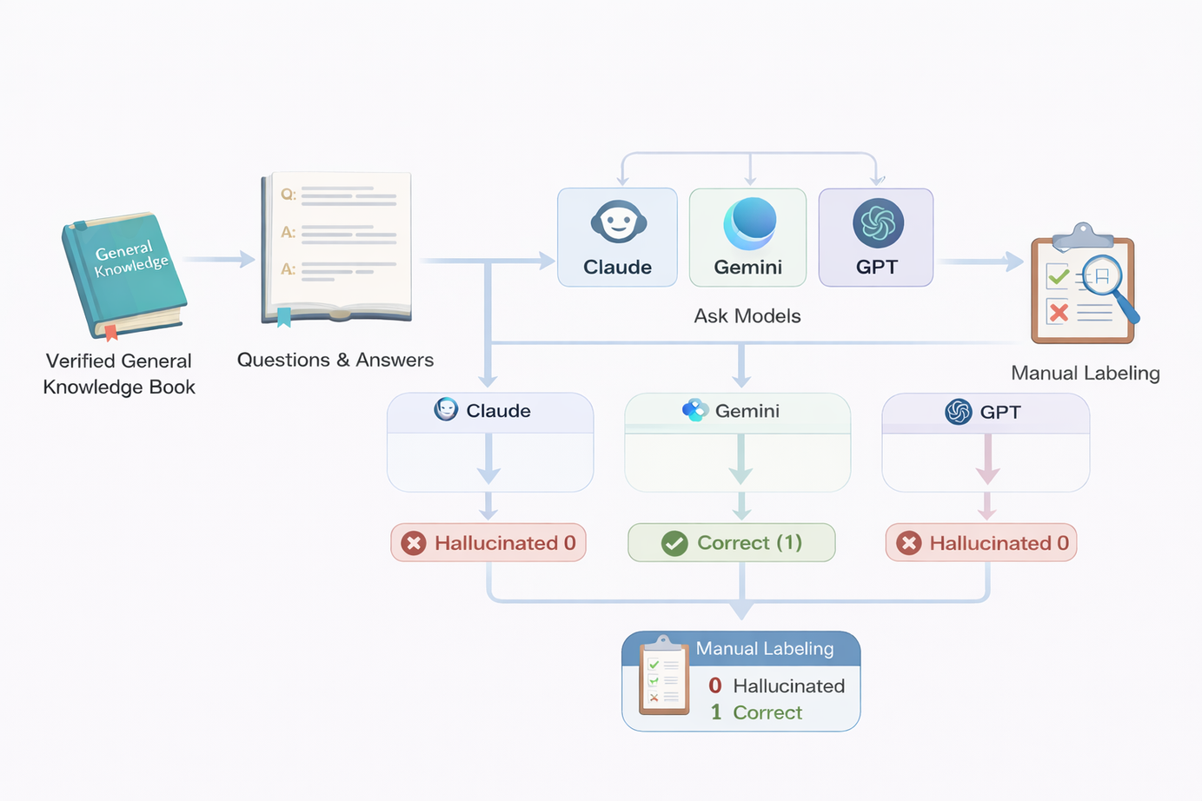
United International University | FYDP III
Dataset Construction
The ground truth was taken from a verified published book to ensure factual accuracy.
9

Slide 11
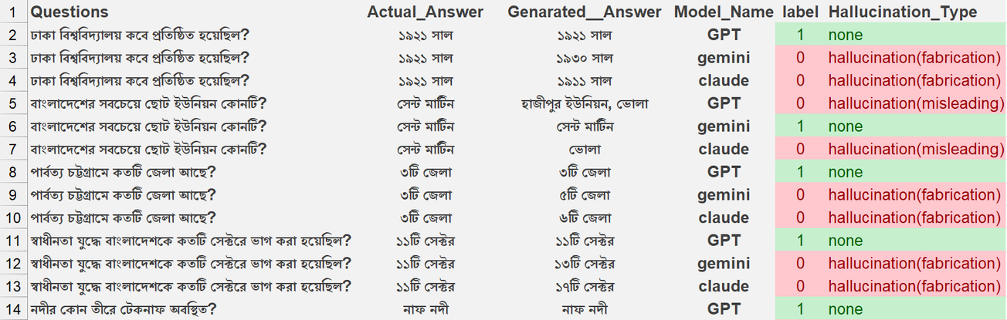
United International University | FYDP III
Sample Dataset
📁 Dataset Overview
🏷 Labeling Strategy
⚙ Data Preparation
  Noise and duplicate removal
  80% Training / 20% Testing split
  Total Samples: 7,043 labeled instances
  Binary Classification:
0 → Hallucinated
1 → Correct
10

Slide 12
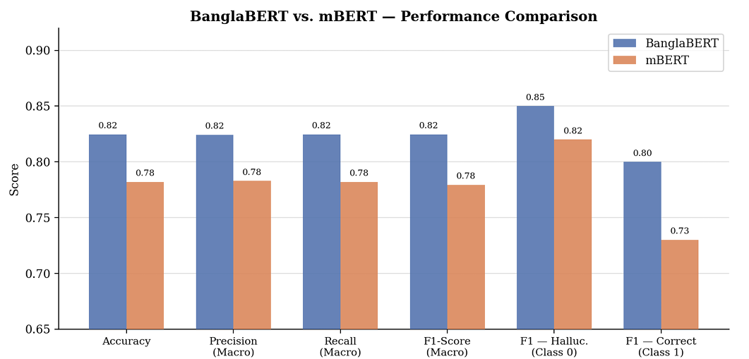
United International University | FYDP III
Result
Two transformer-based models were evaluated:
  mBERT (Multilingual BERT)
  BanglaBERT (Bangla-specific pretrained model)
Evaluated on:
  Accuracy
  Precision (Macro)
  Recall (Macro)
  F1-Score
BanglaBERT achieved consistently higher performance across all metrics.
Overall accuracy improved from 0.78 to 0.82.
11

Slide 13
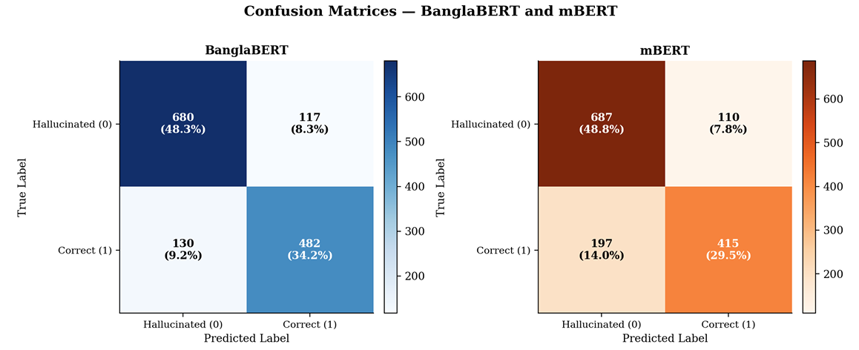
United International University | FYDP III
Metric-wise Performance ComparisonMetric-wise Performance Comparison
📌 Key Observations
  4% improvement in overall accuracy
  Stronger detection of correct responses (Class 1)
  Better class balance
  Reduced misclassification errors
12

Slide 14

United International University | FYDP III
Limitations
  The dataset size is limited compared to large-scale benchmarks.
  Focused primarily on the Bangla language domain.
  Model performance depends on the quality of labeled data.
  Complex hallucination types (subtle factual distortion) remain challenging.
  Evaluation restricted to selected LLM outputs.
13

Slide 15

United International University | FYDP III
Future Work
  Increase dataset size
  Add multi-class labeling
  Improve model architecture
  Apply explainable AI
  Extend to cross-lingual settings
14

Slide 16
United International University | FYDP III
References
Detecting Hallucinations in Large Language Model Generation: A Token Probability Approach
Large Language Models Hallucination: A Comprehensive Survey
Poly-FEVER: A Multilingual Fact Verification Benchmark for Hallucination Detection in Large Language Models
15

Slide 17
United International University | FYDP III
Thank You

